Slide 1




Nubps
App Available
ONLINE PLATFORM FOR PROJECT SELECTION
PRESENTED TO
Md Ahshan Habib
Nusrat Anika
Mahmud Anik
Abdul Khaleque
Abdullah Al Noman
Nusrat Jahan Joya
PRESENTED BY
Md Reja E Rabbi Tonmoy
23/05/2024

Slide 2
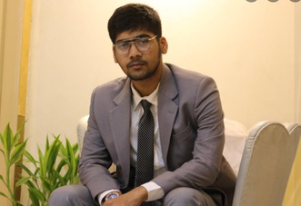
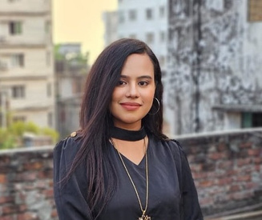
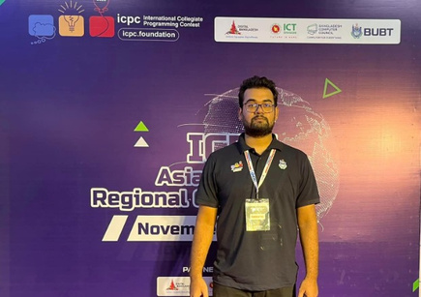
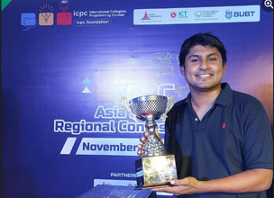
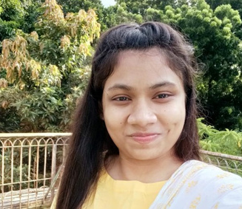

Nubps
Md Ahshan Habib
ID: 41220100052
Nusrat Anika
ID: 41220100051
Introducing
Our Team Member
Mahmud Anik
ID: 41220101630
Abdul Khaleque
ID: 41220100106
Nusrat Jahan Joya
ID: 41220100118
Abdullah Al Noman
ID: 41220100111

Slide 3

Nubps
Project Overview
Our platform transforms how students and teachers work together on projects. It makes managing projects easy and encourages students to get involved actively. This helps students do well in their studies while also sparking new ideas and creativity.

Slide 4

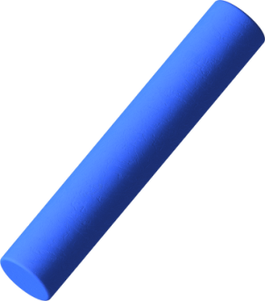

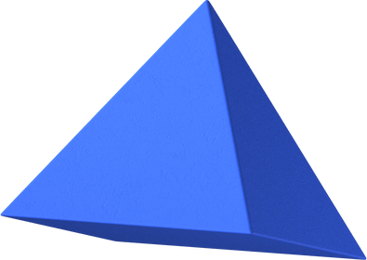
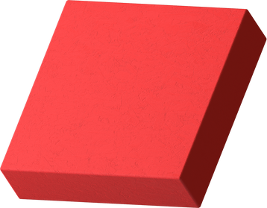
PROJECT
TIMELINE
For the teacher:
The project timeline can be used to give an overview of when the project is to be carried out. It can be broken down to specific dates or through weeks. A calendar like below can be used, or a simple list of tasks and its due dates.
 | WEEK 1 | WEEK 2 | WEEK 3 | WEEK 4 | WEEK 5
Task name | ER Diagram | Creating Database Environments | Student Group Creation Logic | Weekly Task Management system and Progress marking | Notice System
Task name | Student Dashboard Frontend | Login/Signup Template | Project Submission and Modification Logic | Student Present/Absent system | beta Android Version Notification system
Task name | Teacher Dashboard Frontend | Login/Signup Backend | Teacher student’s Group Selection | Comment System | Making Moderator To approve the student IDs

Slide 5

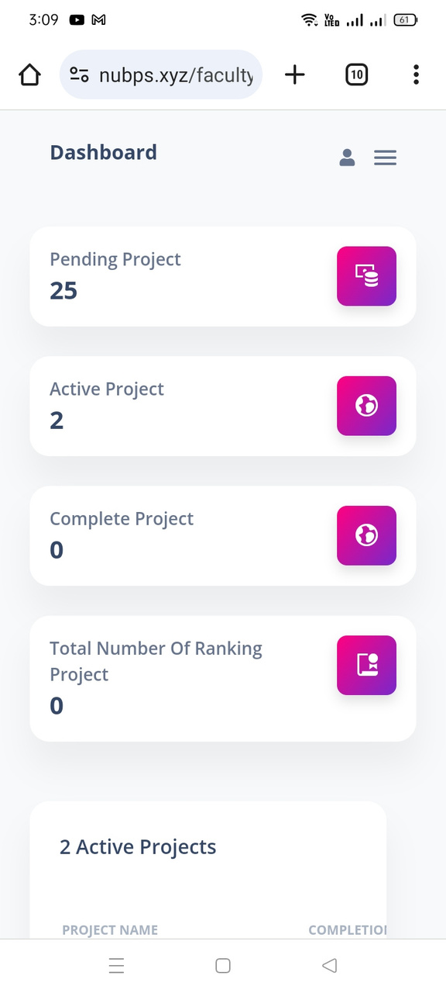





Nubps
We are Using

Slide 6
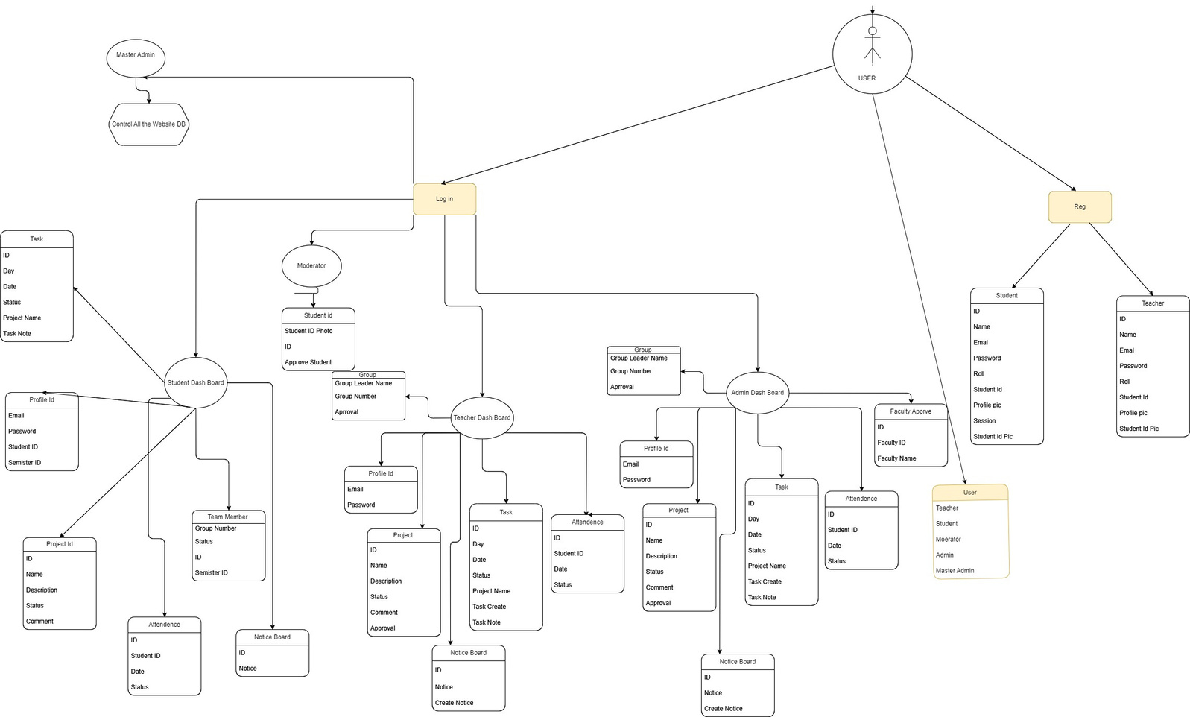
Nubps
ER Diagram

Slide 7
Nubps
Role
Department Head
Student
Teacher
Moderator
Master Admin

Slide 8

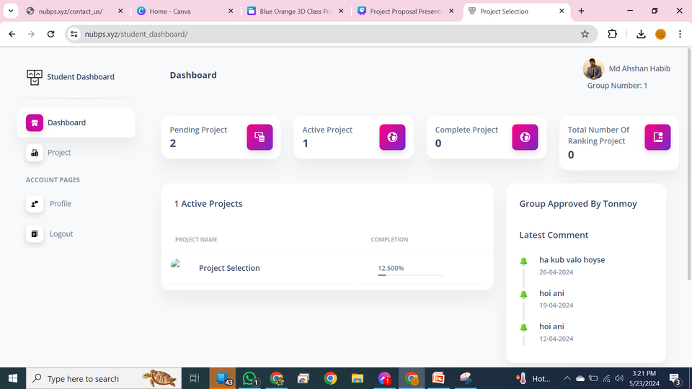
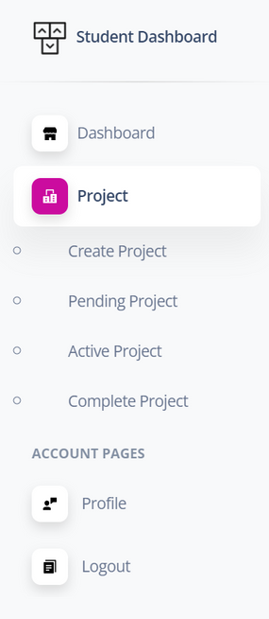
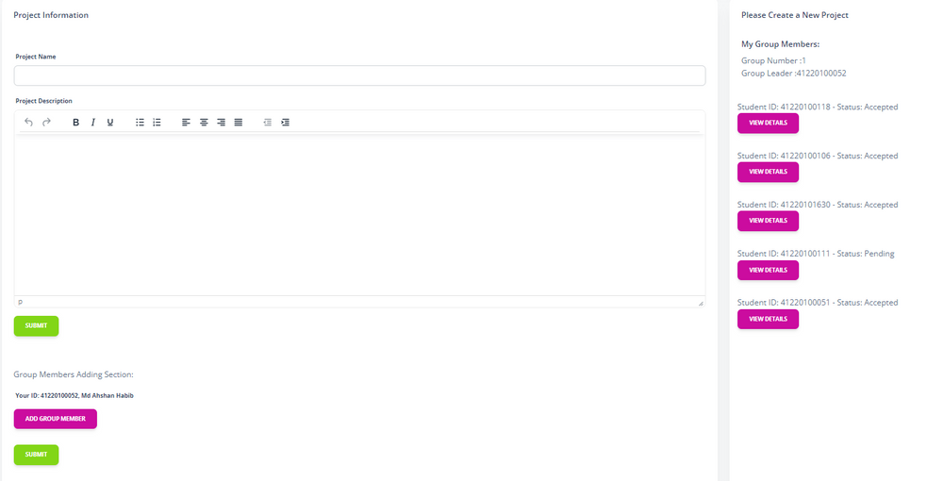
Nubps
Student Dashboard
Home Page
Group & Project Creation
Menu Bar

Slide 9
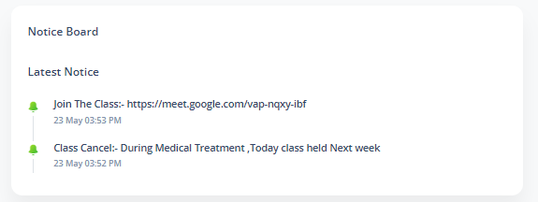
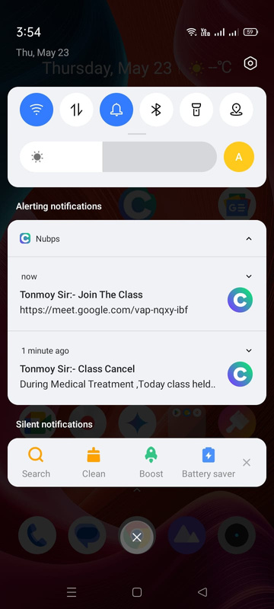
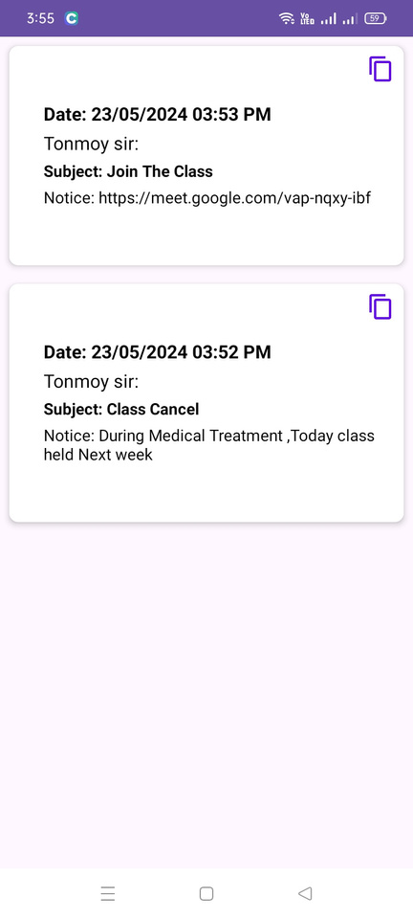
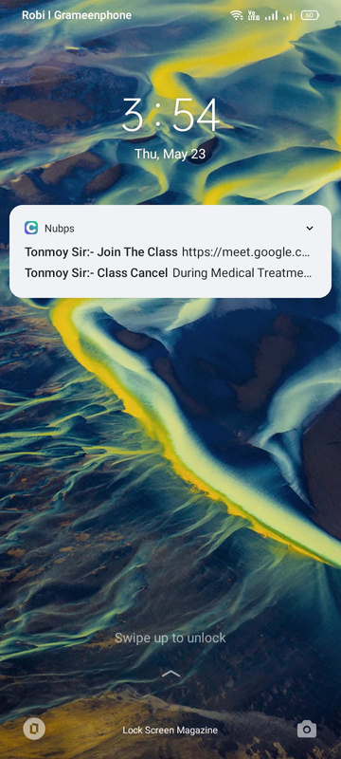
Nubps
Website View
Student Dashboard
Notice Board
App View

Slide 10
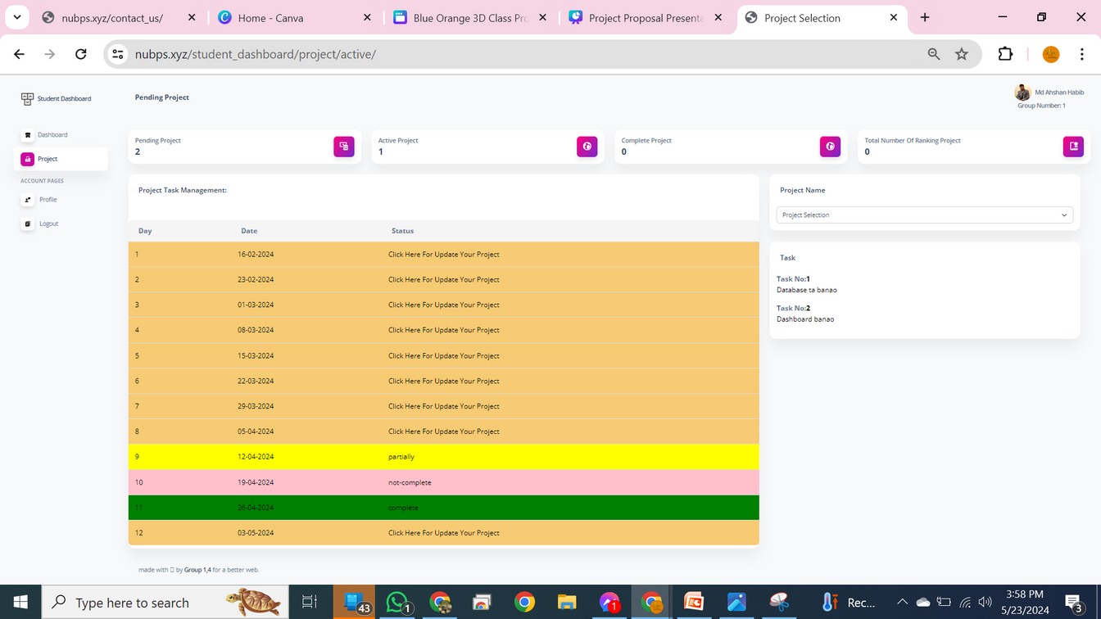
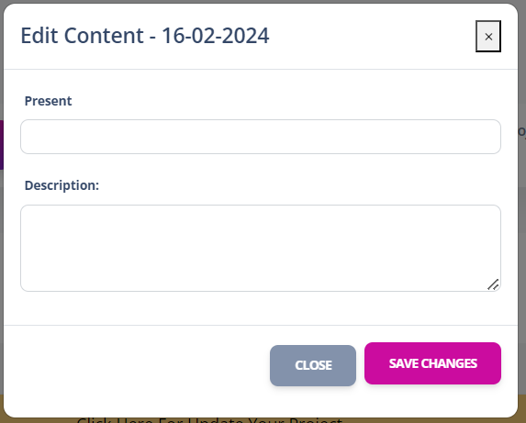
Nubps
Student Dashboard
Task Management

Slide 11
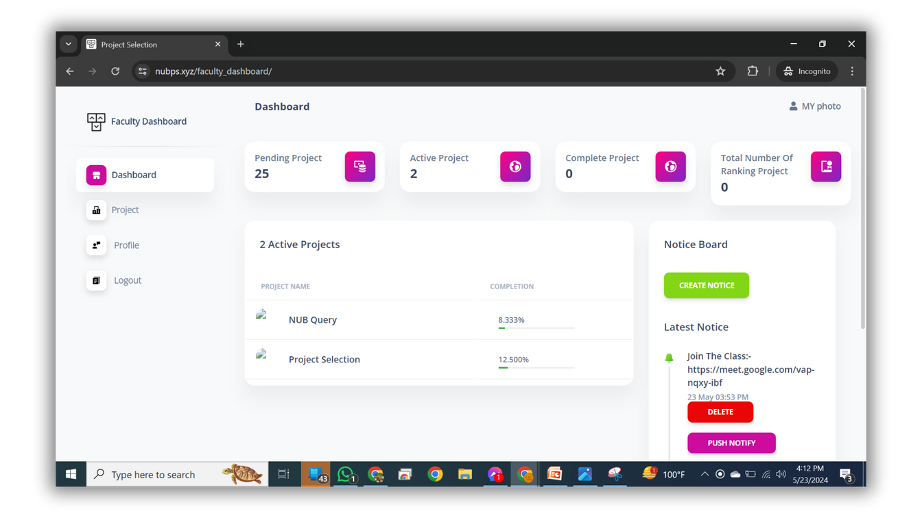
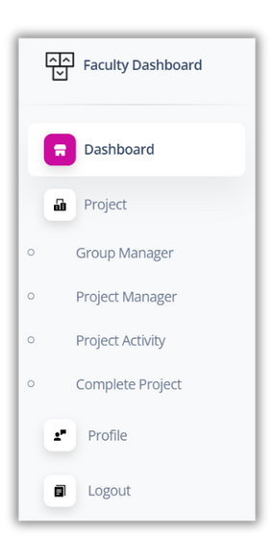
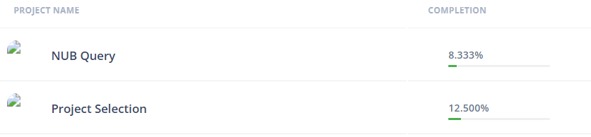
Nubps
Teacher Dashboard
Home Page
Menu Bar
Project Progress

Slide 12
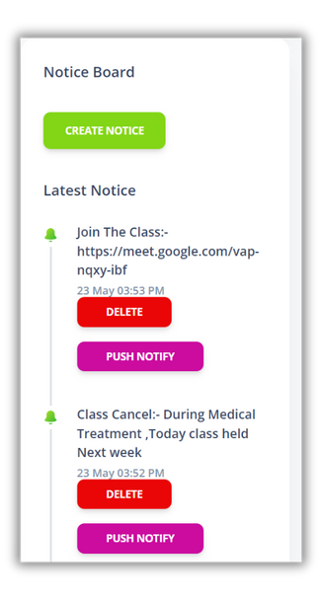
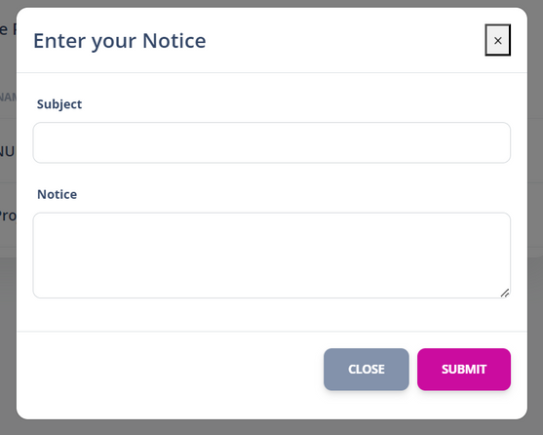
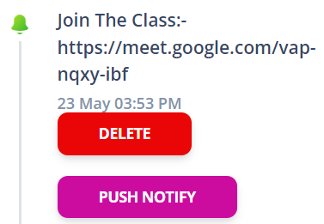
Nubps
Notice Board
Teacher Dashboard
When You Click The
Push It can send
notification
of all device
Notice Creation

Slide 13
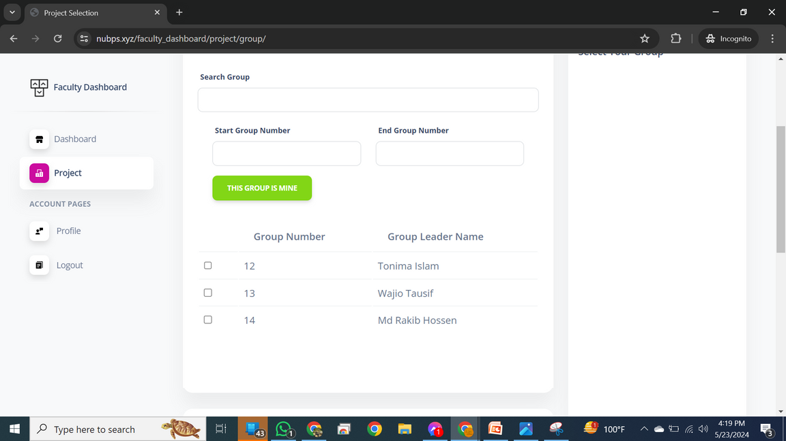
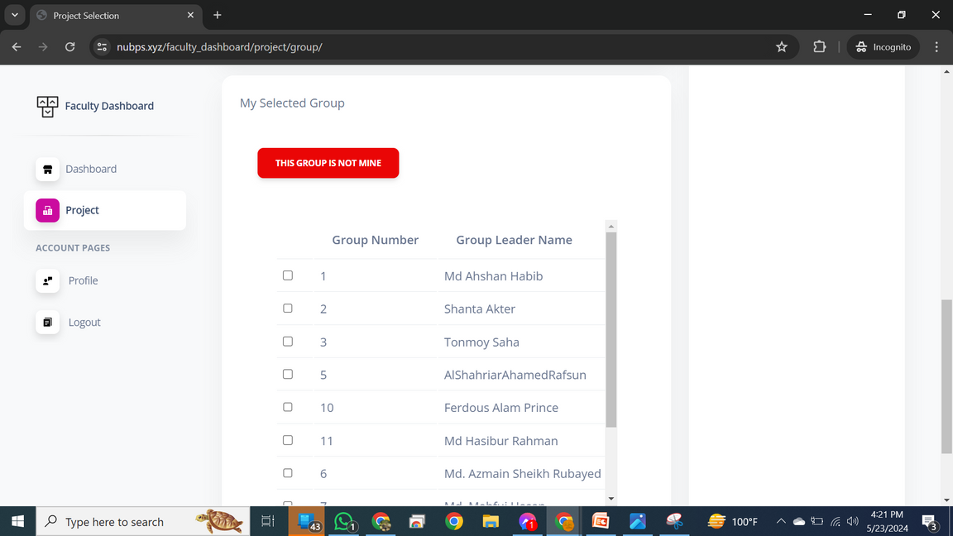
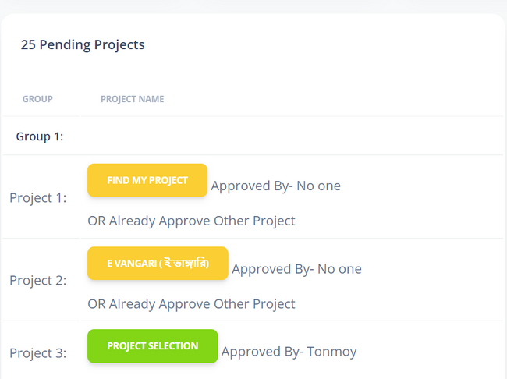
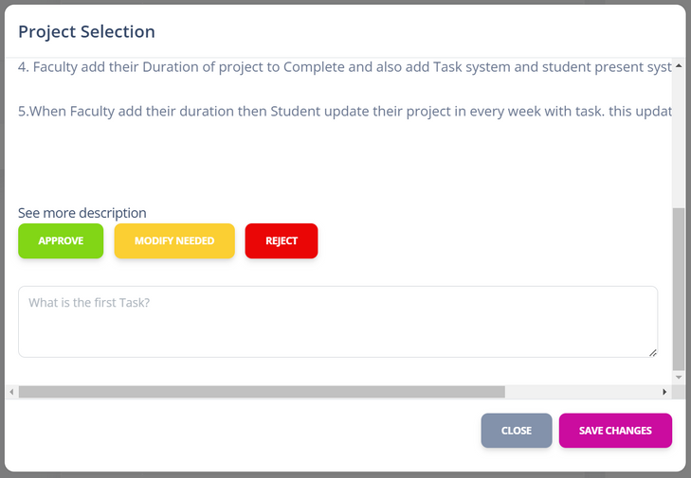
Nubps
Teacher Dashboard
Group Manager
Approval Group
Approval Group Project
Project Approval

Slide 14
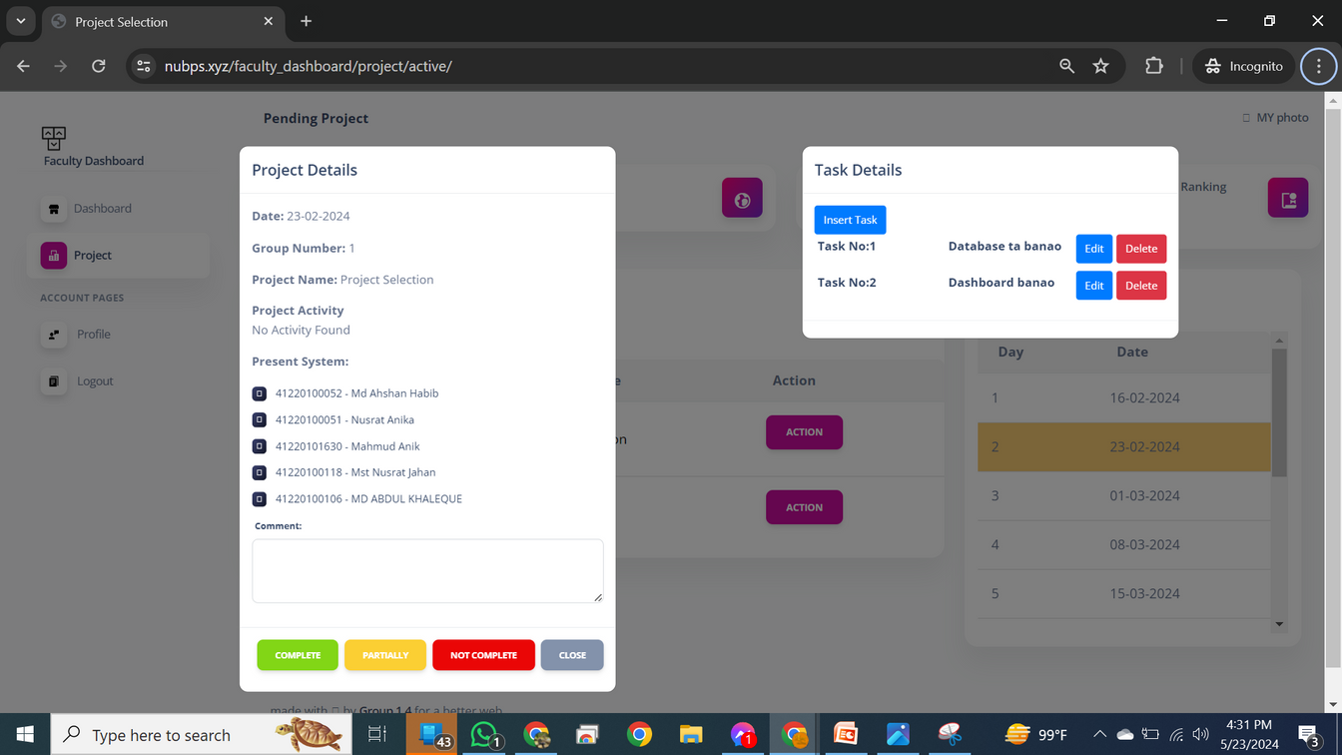
Nubps
Teacher Dashboard
Project Activity And Task

Slide 15
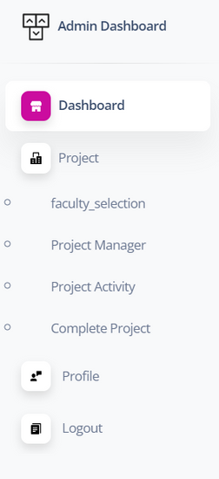
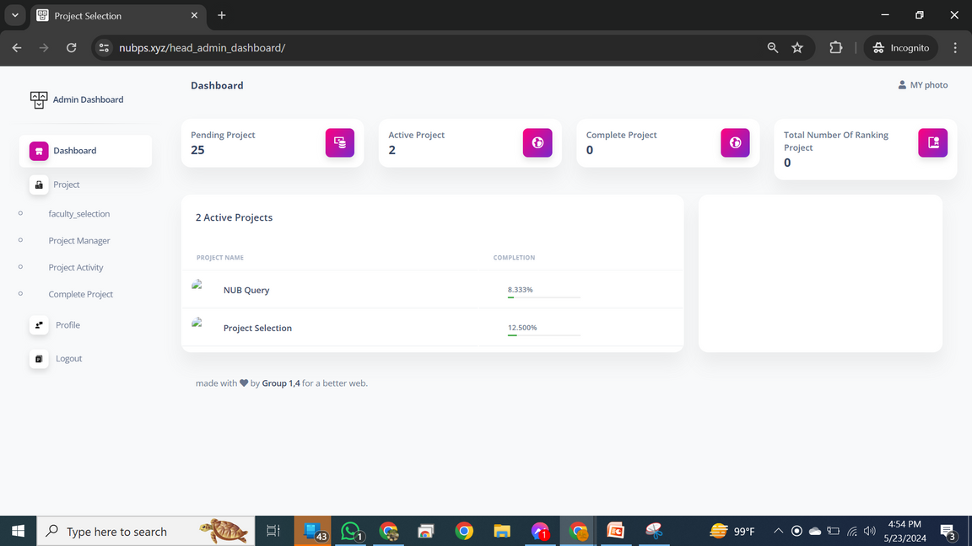

Nubps
Department Head
Home Page
Menu Bar

Slide 16
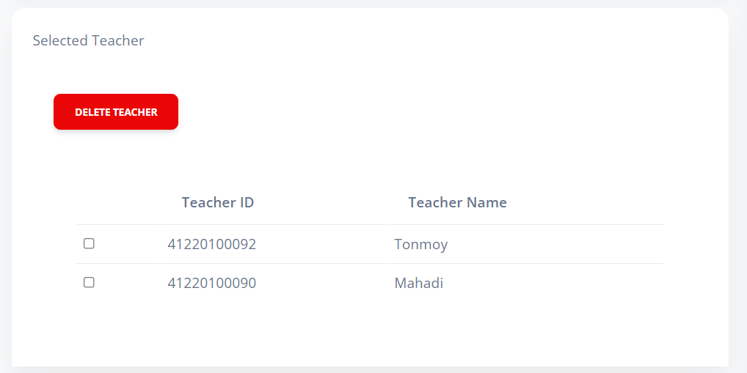
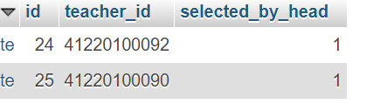
Nubps
All As Same As Teacher Dashboard
Different only One things
Department Head
Faculty Selection
Department Head Control the
Faculty member and also student
Database

Slide 17
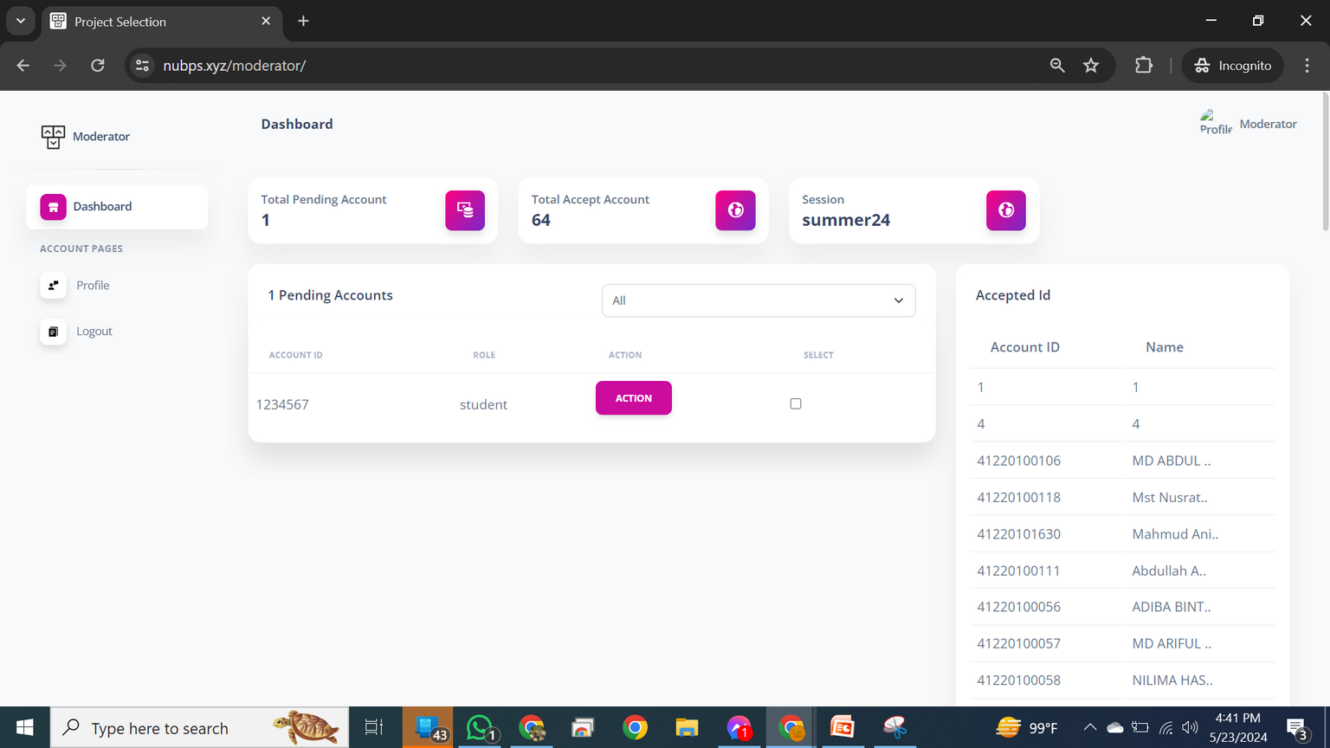
Nubps
Moderator
Dashboard
Home Page

Slide 18
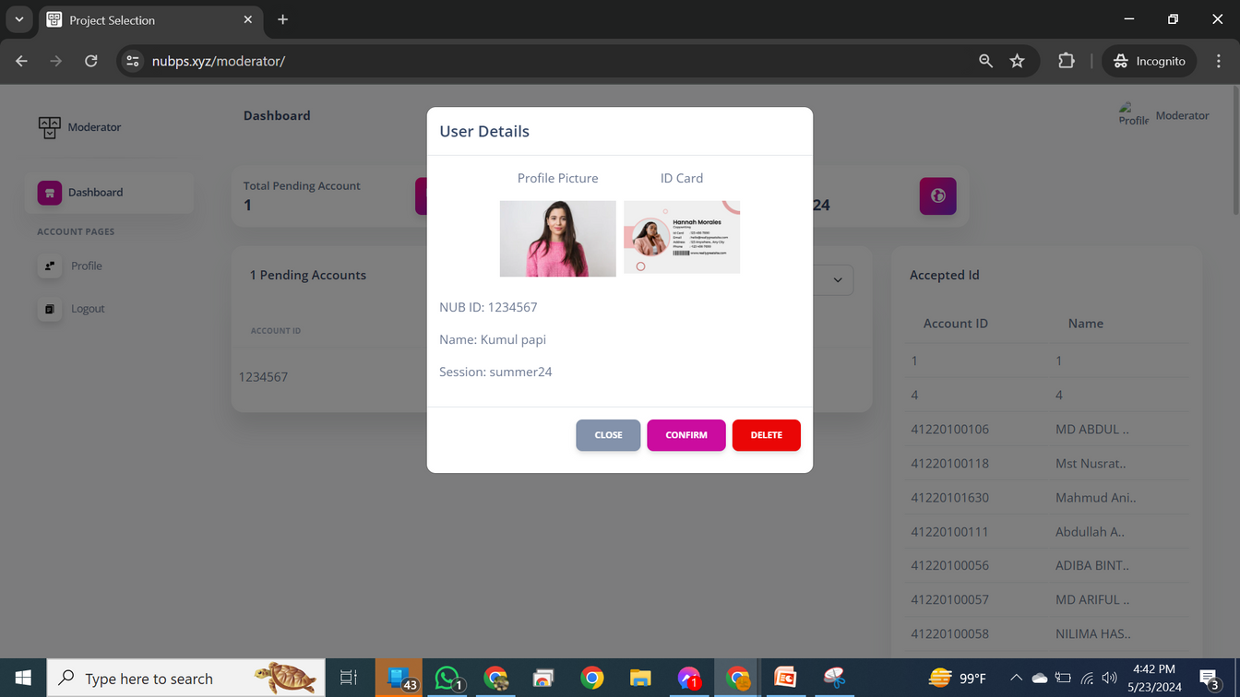
Nubps
Moderator
Dashboard
Student Approval
If ID match with Institution ID card Then approve otherwise
reject.

Slide 19
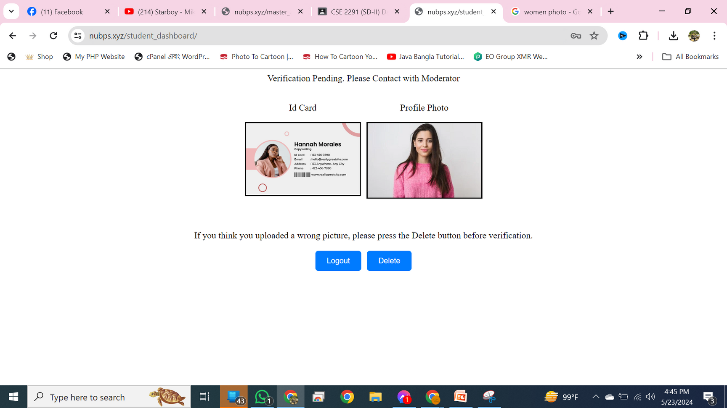
Nubps
Without Moderator Approval
Student Can not Enter Student Dashboard
Moderator
Dashboard
If you login

Slide 20
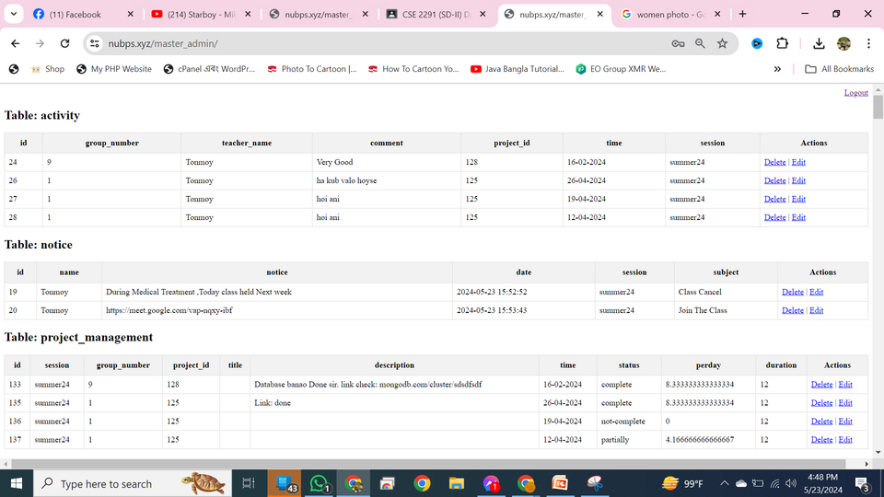
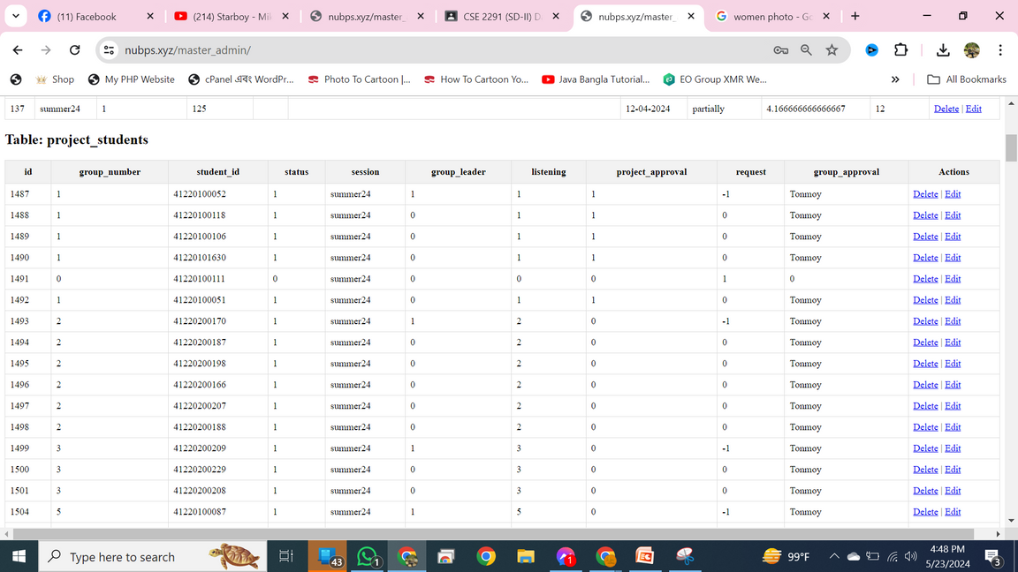
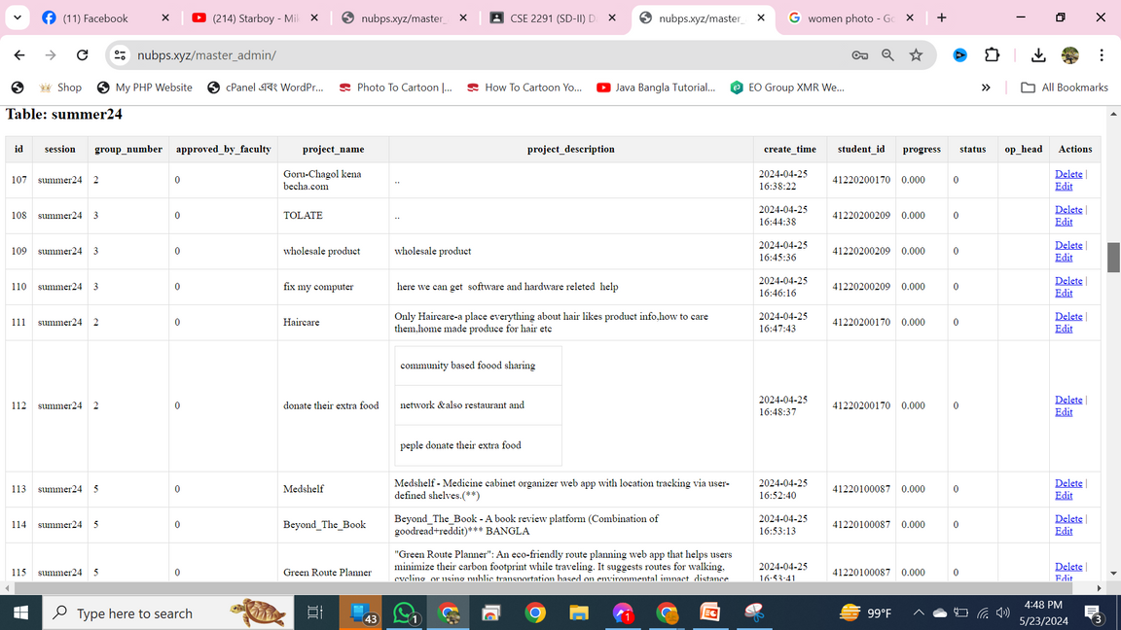
Nubps
Master Admin
Master Admin is a Full control of Database
Master admin Add,remove , update everything can do

Slide 21
Nubps
For inquiries, contact us.
Website:
https://www.nubps.xyz

